Slide 1
Object-Oriented Programming (OOP)
Lecture No. 16

Slide 2
Operator overloading
Consider the following class:
  class Complex{
  private:
  double real, img;
  public:
  Complex Add(const Complex &);
  Complex Subtract(const Complex &);
  Complex Multiply(const Complex &);
  …
  }

Slide 3
Operator overloading
Function implementation:
  Complex Complex::Add(
  const Complex & c1){
  Complex t;
  t.real = real + c1.real;
  t.img = img + c1.img;
  return t;
  }

Slide 4
Operator overloading
The following statement:
  Complex c3 = c1.Add(c2);
  Adds the contents of c2 to c1 and assigns it to c3 (copy constructor)

Slide 5
Operator overloading
To perform operations in a single mathematical statement e.g:
  c1+c2+c3+c4
We have to explicitly write:
c1.Add(c2.Add(c3.Add(c4)))

Slide 6
Operator overloading
Alternative way is:
t1 = c3.Add(c4);
t2 = c2.Add(t1);
t3 = c1.Add(t2);

Slide 7
Operator overloading
If the mathematical expression is big:
  Converting it to C++ code will involve complicated mixture of function calls
  Less readable
  Chances of human mistakes are very high
  Code produced is very hard to maintain

Slide 8
Operator overloading
C++ provides a very elegant solution:
“Operator overloading”
C++ allows you to overload common operators like +, - or * etc…
Mathematical statements don’t have to be explicitly converted into function calls

Slide 9
Operator overloading
Assume that operator + has been overloaded
Actual C++ code becomes:
  c1+c2+c3+c4
The resultant code is very easy to read, write and maintain

Slide 10
Operator overloading
C++ automatically overloads operators for pre-defined types
Example of predefined types:
  int
  float
  double
  char
  long

Slide 11
Operator overloading
Example:
  float x;
  int y;
  x = 102.02 + 0.09;
  Y = 50 + 47;

Slide 12
Operator overloading
The compiler probably calls the correct overloaded low level function for addition i.e:
  // for integer addition:
  Add(int a, int b)
  // for float addition:
  Add(float a, float b)

Slide 13
Operator overloading
Operator functions are not usually called directly
They are automatically invoked to evaluate the operations they implement

Slide 14
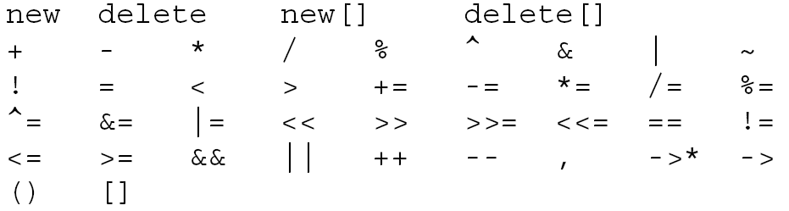
Operator overloading
List of operators that can be overloaded in C++:

Slide 15
Operator overloading
List of operators that can’t be overloaded:
Reason: They take name, rather than value in their argument except for ?:
?: is the only ternary operator in C++ and can’t be overloaded

Slide 16
Operator overloading
The precedence of an operator is NOT affected due to overloading
Example:
  c1*c2+c3
  c3+c2*c1
  both yield the same answer

Slide 17
Operator overloading
Associativity is NOT changed due to overloading
Following arithmetic expression always is evaluated from left to right:
  c1 + c2 + c3 + c4

Slide 18
Operator overloading
Unary operators and assignment operator are right associative, e.g:
  a=b=c is same as a=(b=c)
All other operators are left associative:
  c1+c2+c3 is same as
  (c1+c2)+c3

Slide 19
Operator overloading
Always write code representing the operator
Example:
  Adding subtraction code inside the + operator will create chaos

Slide 20
Operator overloading
Creating a new operator is a syntax error (whether unary, binary or ternary)
You cannot create $

Slide 21
Operator overloading
Arity of an operator is NOT affected by overloading
Example:
  Division operator will take exactly two operands in any case:
  b = c / d

Slide 22
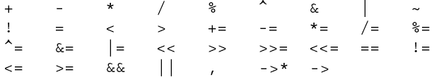
Binary operators
Binary operators act on two quantities
Binary operators:

Slide 23
Binary operators
General syntax:
  Member function:
  TYPE₁ CLASS::operator B_OP(
  TYPE₂ rhs){
  ...
  }

Slide 24
Binary operators
General syntax:
  Non-member function:
  TYPE₁ operator B_OP(TYPE₂ lhs, TYPE₃ rhs){
  ...
  }

Slide 25
Binary operators
The “operator OP” must have at least one formal parameter of type class (user defined type)
Following is an error:
  int operator + (int, int);

Slide 26
Binary operators
Overloading + operator:
  class Complex{
  private:
  double real, img;
  public:
  …
  Complex operator +(const Complex & rhs);
  };

Slide 27
Binary operators
  Complex Complex::operator +( const Complex & rhs){
  Complex t;
  t.real = real + rhs.real;
  t.img = img + rhs.img;
  return t;
  }

Slide 28
Binary operators
The return type is Complex so as to facilitate complex statements like:
  Complex t = c1 + c2 + c3;
The above statement is automatically converted by the compiler into appropriate function calls:
  (c1.operator +(c2)).operator +(c3);

Slide 29
Binary operators
If the return type was void,
  class Complex{
  ...
public:
void operator+(
const Complex & rhs);
  };

Slide 30
Binary operators
void Complex::operator+(const Complex & rhs){
real = real + rhs.real;
img = img + rhs.img;
};

Slide 31
Binary operators
we have to do the same operation c1+c2+c3 as:
  c1+c2
  c1+c3
  // final result is stored in c1

Slide 32
Binary operators
Drawback of void return type:
  Assignments and cascaded expressions are not possible
  Code is less readable
  Debugging is tough
  Code is very hard to maintain

